Slide 1
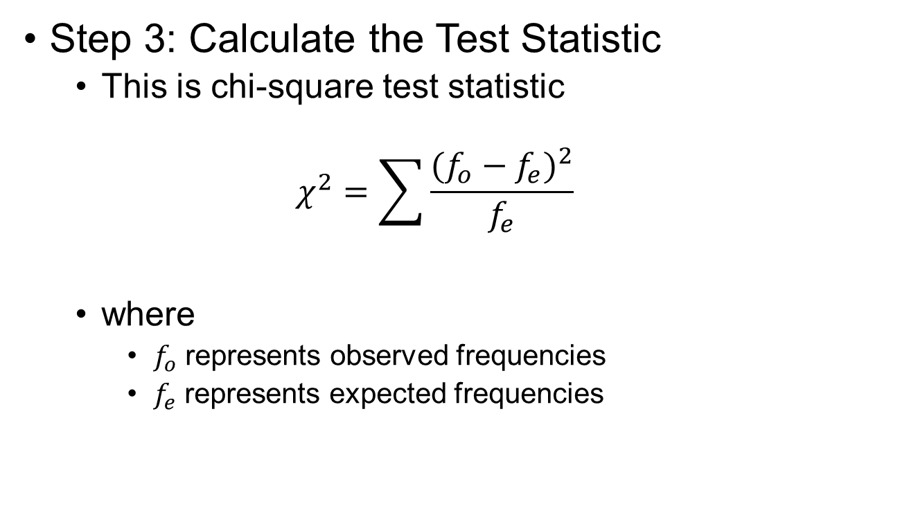
Chi-Square Hypothesis Test
Step 3: Calculate the Test Statistic
This is chi-square test statistic
$$χ^{2}=\sum{\frac{{(f_{o}−f_{e})}^{2}}{f_{e}}}$$
where
$f_{o}$ represents observed frequencies
$f_{e}$ represents expected frequencies

Slide 2
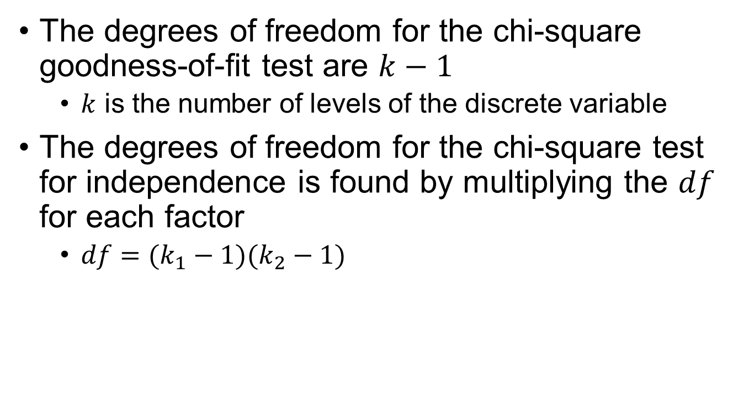
Degrees of Freedom
The degrees of freedom for the chi-square goodness-of-fit test are $k−1$
$k$ is the number of levels of the discrete variable
The degrees of freedom for the chi-square test for independence is found by multiplying the $df$ for each factor
$df=(k_{1}−1)(k_{2}−1)$

Slide 3
Expected Frequencies
Computing expected frequencies:
$$\frac{ac}{n}$$ | $$\frac{bc}{n}$$ | $$c$$ $$d$$
$$\frac{ad}{n}$$ | $$\frac{bd}{n}$$
$$a$$ | $$b$$

Slide 4
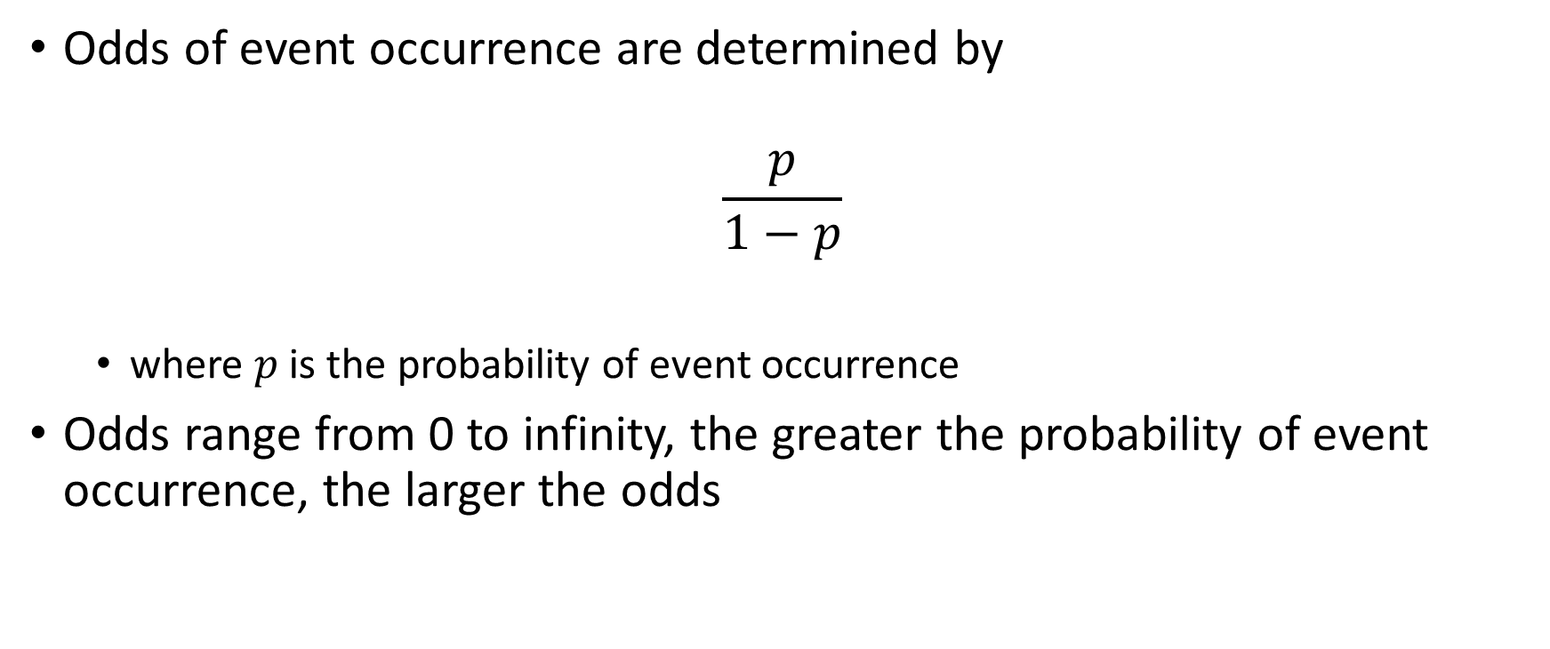
Odds
Odds of event occurrence are determined by
$$\frac{p}{1−p}$$
where $p$ is the probability of event occurrence
Odds range from 0 to infinity, the greater the probability of event occurrence, the larger the odds

Slide 5
Odds Ratio
The odds ratio (OR) is a measure of effect size for a significant χ² test for independence. It is computed by taking the ratio of the odds for each group

